Slide 1
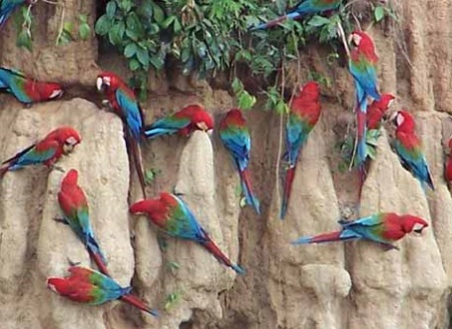
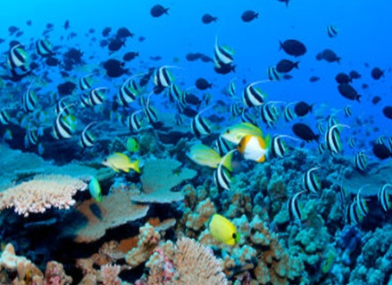
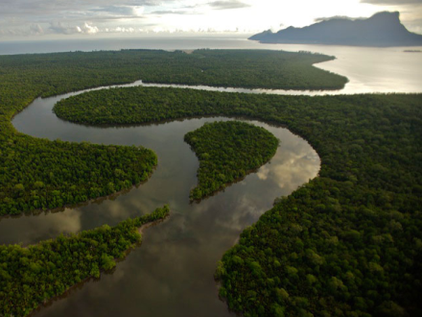
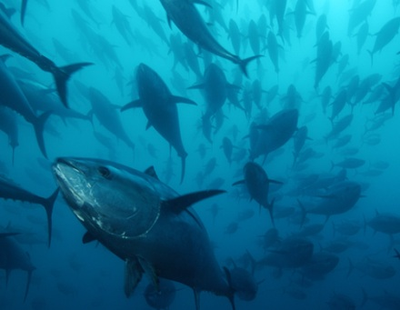
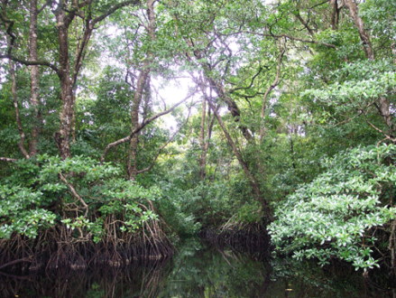
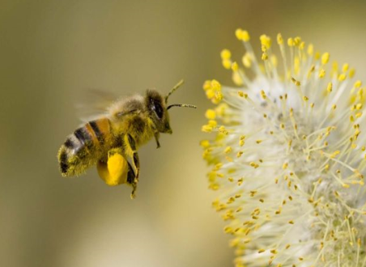
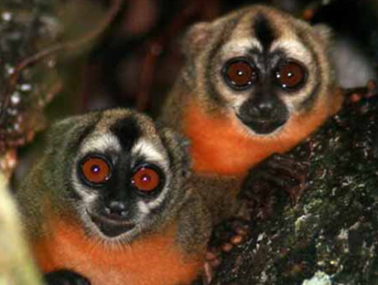
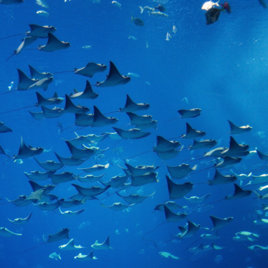
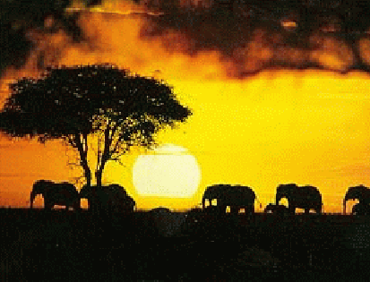
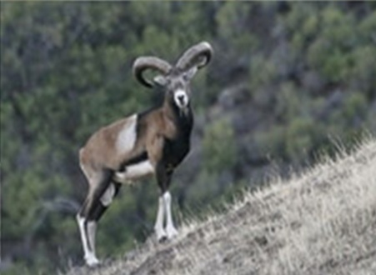
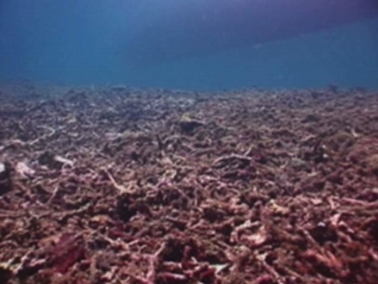
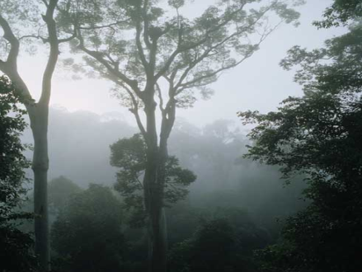
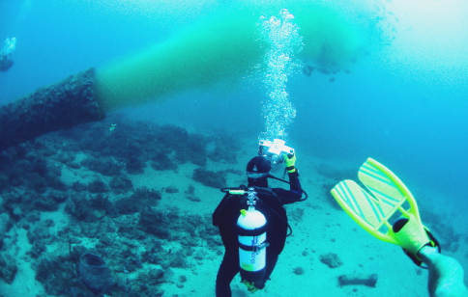
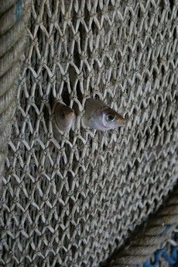
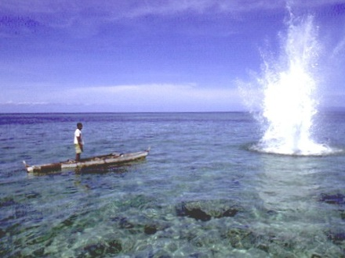
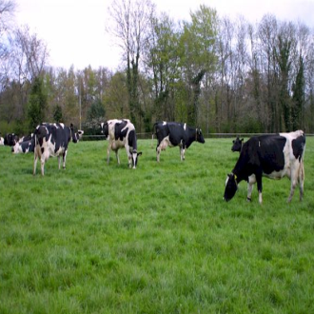
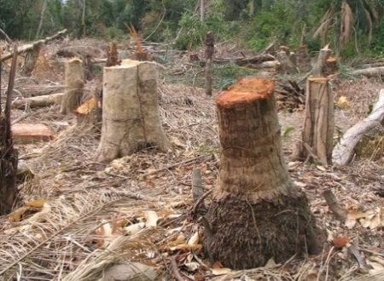

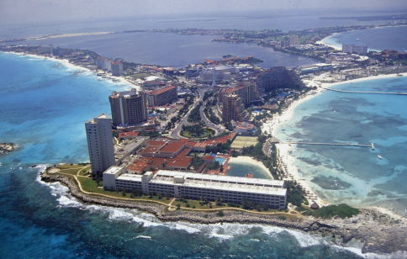
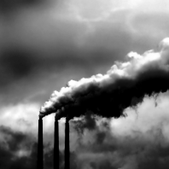
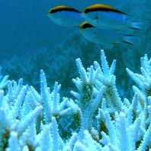
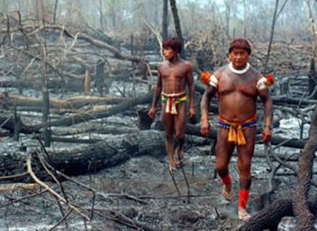
GEO309: Biogeography
Notes:
My research covers a broad spectrum of topics which are related and aim to identify scenarios were biodiversity and human welfare can be ensure. I have work on these different topics for about 10 years now and it is my perception today that we are pretty much screw.

Slide 2
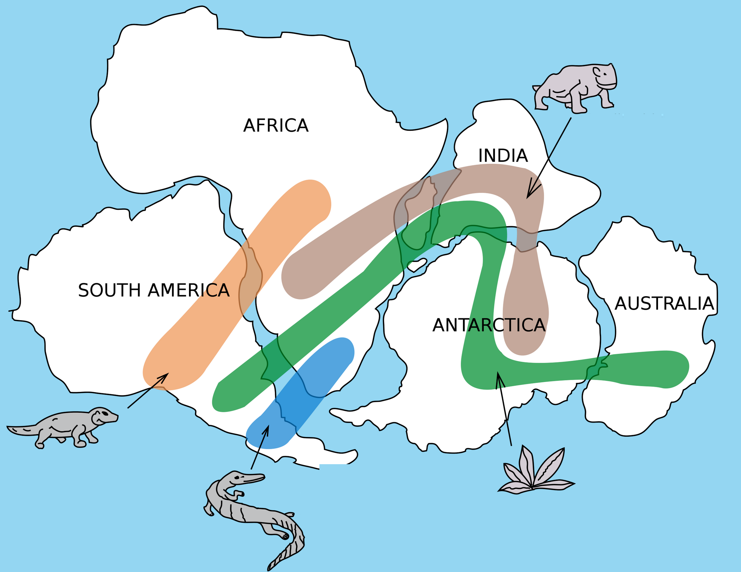
Biogeography is the study of the distribution of species and ecosystems in geographic space and through geological time.

Slide 3
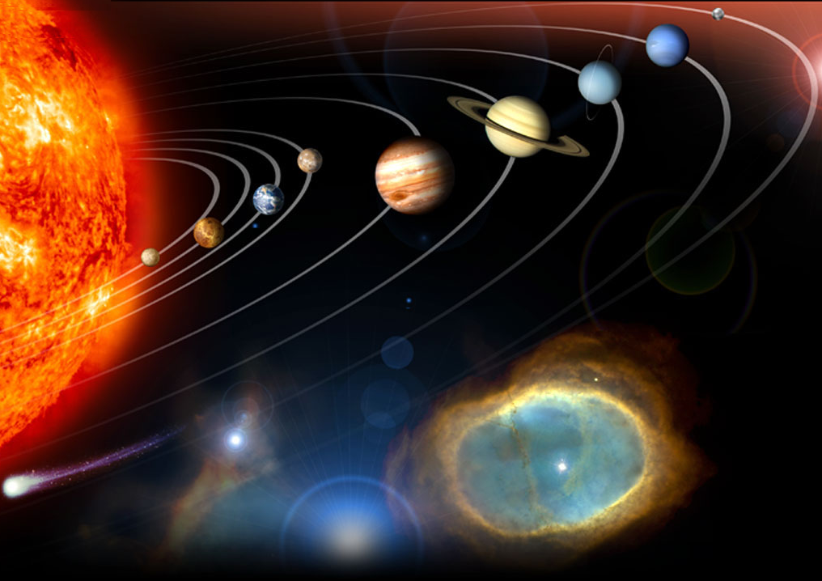
Life, as we know it, occurs within a very narrow set of conditions
1. Source of constant and stable energy
2. A terrestrial planet
3. The right distance from the energy source
To cool
To hot
4. Need a satellite star
5. Near circular orbit
6. The right place in the galaxy
7. Carbon and oxygen
8. Magnetic shield
Notes:
Requirements for life
a solar system with a single massive Sun than can serve as a long-lived, stable source of energy
a terrestrial planet (non-gaseous)
the planet must be the right distance from the sun in order to preserve liquid water at the surface – if it’s too close, the water is burnt off in a runaway greenhouse effect, if it’s too far, the water is permanently frozen in a runaway glaciation
the solar system must be placed at the right place in the galaxy – not too near dangerous radiation, or to be absorb by their gravity
a moon of sufficient mass to stabilize the tilt of the planet’s rotation
A near circular orbit to maintain water in its surface
an oxygen-rich atmosphere
a sweeper planet to deflect comets, etc.
planetary neighbors must have non-eccentric orbits to avoid collitions
Carbon for encoding biological information to allow it to replicate itself. The only element in the periodic table that allows you to encode information is carbon.
Oxigen to fuel metabolisms and independence of organinms
http://winteryknight.wordpress.com/2009/04/02/what-conditions-are-needed-to-create-a-habitable-planet/
http://www.arn.org/docs/gonzalez/gg_arewealone.htm

Slide 4
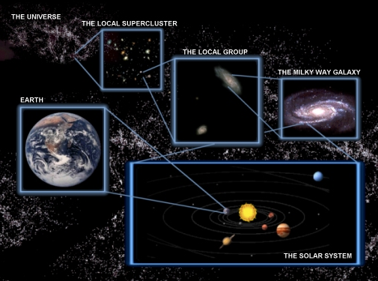
What is the probability of life in other planet in the universe:
As many a 100 billion earth-like planets
~ 10 meet Earth's life conditions
Probability of life = ~0.00000000001
Realistically, we will have nowhere to go if we mess this planet up!
Notes:
At the speed of light it would take 100.000 years to go across the milky way, and just going to Mars has been one of the greatest achivement of human exploration of our universe. Then what will be the odds that we can move somewhere else after messing up this planet?

Slide 5

In contrast to the loneliness of the universe…we share this planet with other ~8.7 million species (Mora et al., PlosBiology 2011)
Air
Water
US$33 trillion per year
(Constanza et al., Nature 1997)
Food
Recreation
Medicine
It does not make any sense for us to tamper with the functioning of the Earths’ systems
Notes:
In contrast to the loneliness of the universe, we share this planet with over 8.7 million species. These species are key to the air we breath, the water we drink and the food we eat….and a long list of good and services to humanity.
If we consider that our own welfare depends on biodiversity and that there is not another planet we can do our experiments in, then it does not make any sense for us to be tampering with basic planetary functions. We are simply playing with fire.

Slide 6
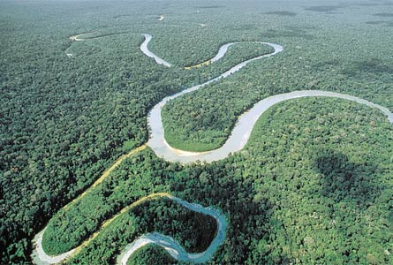
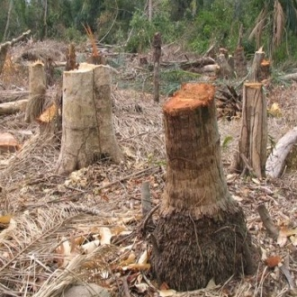
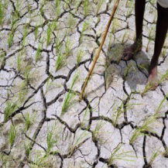

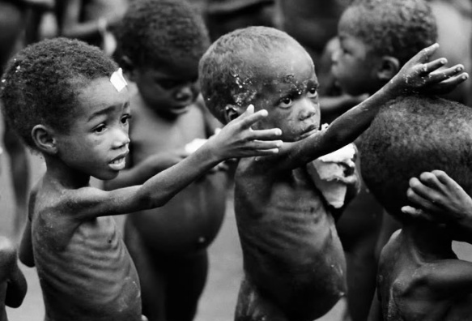
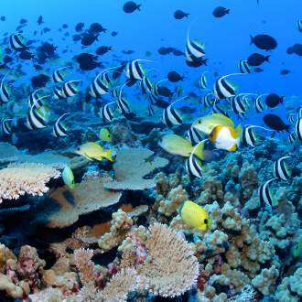
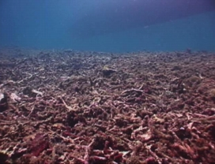

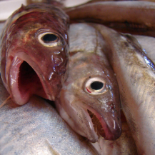
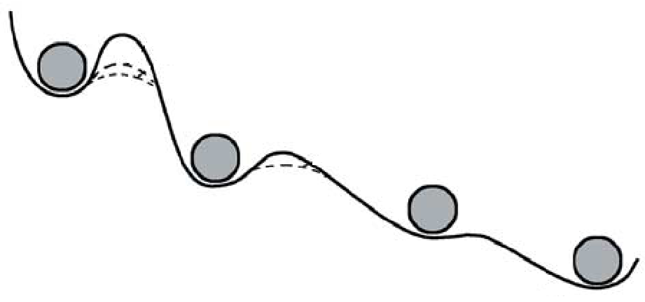
…and the consequences could be devastating.
...BUT, unfortunately, that is exactly what we are doing
Loss of goods and services
Habitat loss
Overexploitation
Climate change
???
???
???
Loss of human welfare
The number of malnourished people in the world is ~1 billion, about a sixth of the world's total population (“FAO, The State of Food Insecurity in the World, 2008 ).
Biodiversity….
….loss is real
100% of the world’s oceans affected by human activities (Halpern et al. Science 2008)
83% of the world’s land affected by human activities (Sanderson et al. BioScience 2002)
6 million hectares of forest deforested annually (Global Biodiversity outlook 2)
Global mangroves declined from 18.8 million ha in 1980 to 15.2 million ha in 2000 (The world’s mangroves 2005)
Sea-grasses are disappearing at 110 km²/yr since 1980. Globally, up to 29% are gone (Waycott et al. PNAS 2009)
Caribbean coral reefs declined by 80% in three decades (Gardner et al Science 2005)
Indo-Pacific coral reefs decline at 0.72% per year since 1997 (Bruno & Selig, PlosOne, 2007)
Large predatory fish declined by 90% since the 50’s (Myers & Worm, Nature 2003)
World’s fisheries could be lost by 2048 (Worm et al., Science 2006)
Some ~3000 monitored wild populations have declined by about 30% since 1970 (Living Planet Index 2010)
One third of the world’s corals are threatened with extinction (Carpenter et al., Science 2008)
Up to 48% of the world’s amphibians have declining populations (Stuart et al., Science 2004)
Populations of vertebrates had declined by an average of 30% in the past 40 years (Hoffmann et al., Science 2010)
This is one billion people for which their nearby environment does not supply enough food already.
Some of the damages can be definitive
Alternative equilibrium states
On average, a person dies every second as a direct or indirect result of poor nutrition (“The right to food : Commission on Human Rights resolution 2002/25”).
Stressor
On average, a child under five dies every five seconds as a direct or indirect result of poor nutrition (“The State of Food Insecurity in the World, 2002).
Depensation
Genetic variability loss
Notes:
5:19min we end up with systems that cannot return to their original states even if the stressors are removed.
5:45min Even now in the first world the thing is turning scary. For instance in the US 50 million people are suffering hunger or at risk of it. In Countries from africa and asia and the southpacific the situation is truly scary.
6:30 min today about 1 billion people, 20% of the world’s human population live near environments that are so deteriorated that basic food supply to humanity is not ensured anymore. The situation is even more critical when you consider future scenarios of clean water supply.
7:05 min Those statisitics are just sad…how, we, as a developed and smart’ species are letting this to happen.

Slide 7
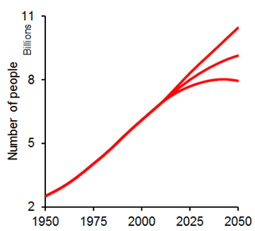
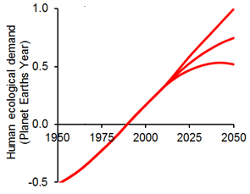
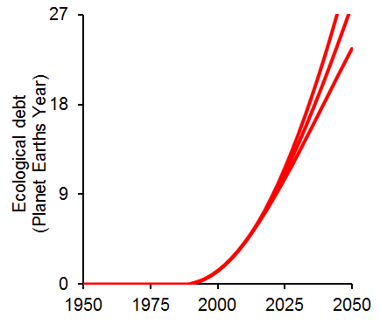
We are in a pathway that is completely unsustainable
12 in Saudi Arabia
9 in the USA
0.68 in Haiti
x Average per capita consumption: 2.1 global hectares a year
/Earth’s biocapacity: 11 billion global hectares a year
Overshoot
All Earth’s biocapacity already consumed
Mora & Sale, MEPS 2011

Slide 8
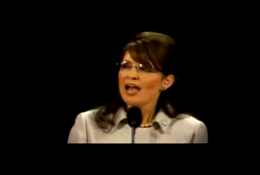




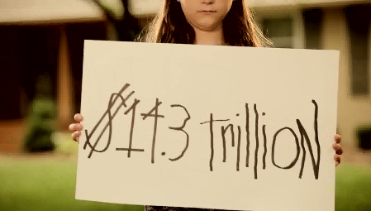
The chances of welfare distress are very large
Increase taxes
Reduce extent of services
Increase debt
We are almost in a trap where better knowledge will be our main scape
Notes:
At least the will have limonate.

Slide 9
Sound strategies
Political will
Human compliance
Global warming control: US$400 billion in the US
Fisheries: US$5.7 billion per year worldwide
Wastewater control: US$4 million per year (Florida keys)
Conflicts of interest
Increase compliance
What to prevent
How to ensure the maintenance of biodiversity?
Causality of threats
Diversity drivers
Protection
Identifying the causal link between biodiversity declines and threats
How biodiversity is maintained and regulated
Conservation economical deficit:
MPAs receive ~1/3 of the budget they need
Low investment to reduce global warming
Increase compliance
Prioritizing on what to protect and why

Slide 10
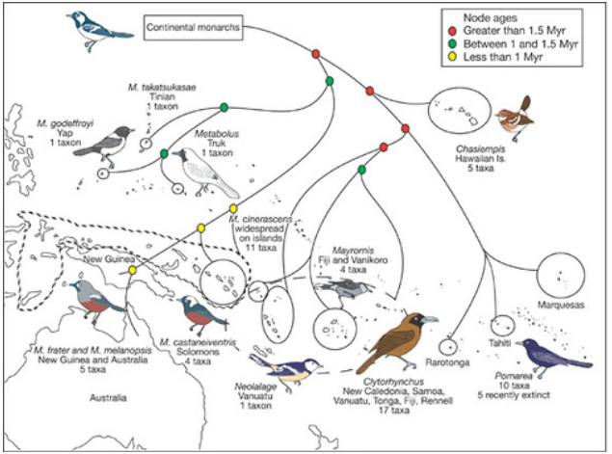
About doing Research in Biogeography

Slide 11
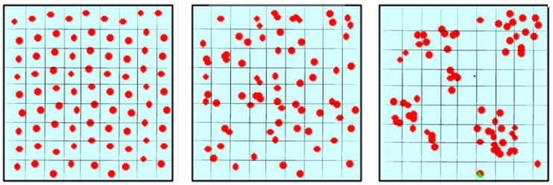
About doing Research in Biogeography
Process
Pattern
The most likely mechanism that causes the pattern; or the why of the pattern
Variation, or lack thereof, in the spatial or temporal distribution of “things”
?

Slide 12

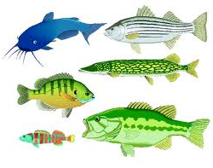
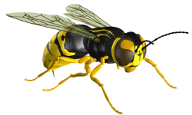

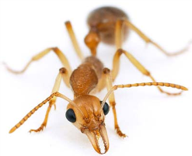
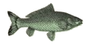

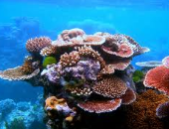
The system
The attribute
Pattern and its process (es)
Number of species
Interest, observation and question
Obtain data
Body size
Build pattern
Test hypotheses
Abundance

Slide 13
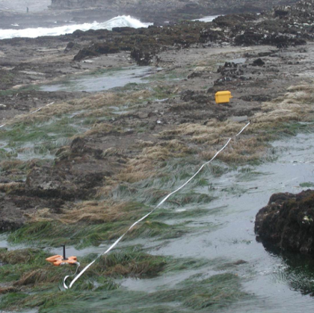
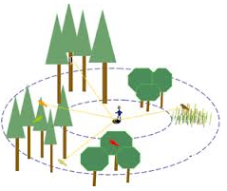
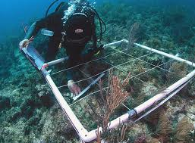
Pattern and its drivers
The transect
Observation and question
Obtain data
The point count
Build pattern
Test hypotheses
The quadrat

Slide 14
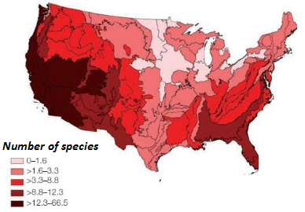
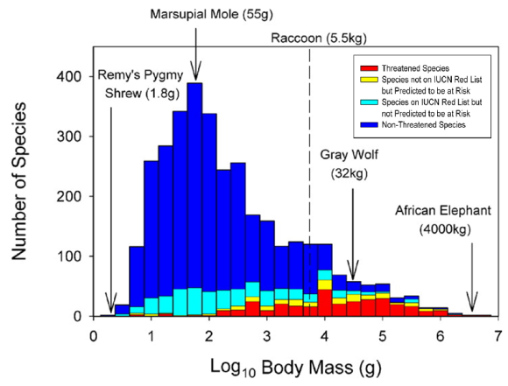
Pattern and its drivers
Species richness
Observation and question
Obtain data
Build pattern
Test hypotheses

Slide 15
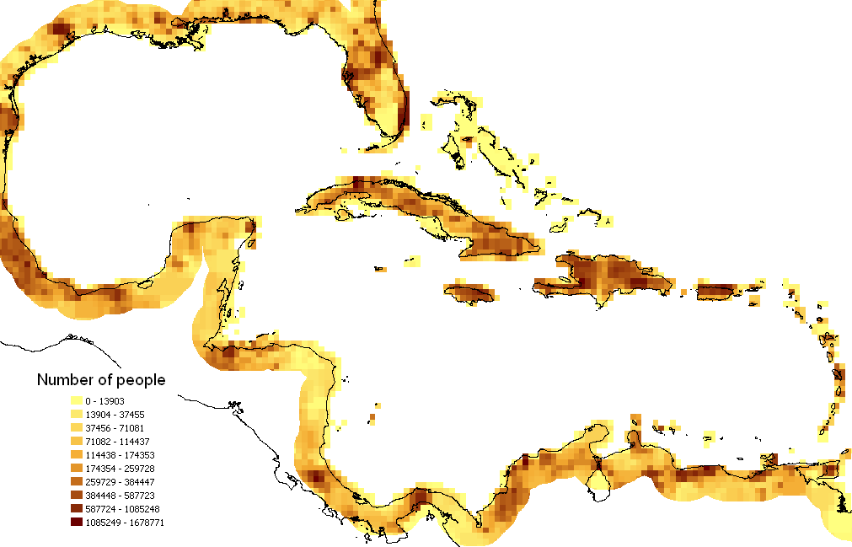







Independent variable:
environmental and anthropogenic variables
Pattern and its drivers
Observation and question
Obtain data
Build pattern
Collect more data
Test hypotheses

Slide 16



Examples of bio-geographical patterns
The latitudinal gradient in species richness
Willig et al (Annu. Rev. Ecol. Syst. 2003)

Slide 17



Examples of bio-geographical patterns
The latitudinal gradient in body size
Or Bergmann’s Rule
Energy requirements
Energy availability

Slide 18


Examples of bio-geographical patterns
Patterns in abundance
Energy requirements
Energy availability
Life history

Slide 19
About doing Research in Biogeography
A major issue
NOVELTY
Google search on:
Keyword
Hits
Species richness
412,000
Body size biogeography
60,900
Abundance biogeography
90,200
What are the chances that we can discover a new pattern or process?

Slide 20

Most often, advance comes from reassessment of patterns and ideas than from the generation of new ones
Interpretation:
Change view on niche theory
Critical observation:
Solve mystery about how corals colonized the Eastern Pacific

Slide 21

About doing Research in Biogeography
However, do not expect things to be easy: ROBUSTNESS
Sampling size
Number of species
Optimum sample size
Number of quadrats
You need some type of test to determine that the data are sufficient to test your idea

Slide 22

About doing Research in Biogeography
The problem of scale: time
Biological systems are characterized by their variability
Small scale
Large scale
Population variability
does not match environmental variability
So, very often, robust patterns require data over long time scales

Slide 23

About doing Research in Biogeography
The problem of scale: space
Biological systems often operate over large geographical scales
10s, 100s or 1000s of kilometers
So, very often, robust patterns require data over large spatial scales

Slide 24
About doing Research in Biogeography
Some common errors: Data standardization
x
x
sps/area
Equal number of samples
Site A
Site B



sps/area
Tropics
Species
Sample 1
Sample 2

High latitude
Area
Area
Species = c*Area^{z}
Asymptotic number of species
Species = c + z*log(Area)
Sps / log10(area)
Notes:
12 minutes

Slide 25



About doing Research in Biogeography
Some common errors: Pseudo-replication
Data from experiments where either treatments are not replicated (though samples may be) or samples are not statistically independent (Hurlbert, Ecol. Monograp. 1984)
What is the thermal tolerance of fish?
Control
x
Zero mortality
Average mortality at 35ºC
N=1000 individuals
Demonic intrusion: Any external and non-controlled factor that may influence your results
It is common practice to have random and replicated samples
Hurlbert, Ecological Monographs 1984

Slide 26

About doing Research in Biogeography
Some common errors: Pseudo-replication
Average=30, Standard deviation=0
Average=25, Standard deviation=5
Temperature?
Average=0, Standard deviation=60
Again, if replicates are not feasible, at the bare minimum such samples should be random

Slide 27


About doing Research in Biogeography
Some common errors: Self-correlation
Standardize by area
Bird & Duarte, Canadian Journal of Fisheries and Aquatic Sciences 1989

Slide 28
About doing Research in Biogeography
Some common errors: Multicollinearity
Response variable
Predictor 1
Predictor 1
Predictor 2
Predictor 2
Graham (2003): multicollinearity can lead to:
⇒ Spurious correlations (Type I errors)
⇒ Reduce statistical power of true relationships
⇒ Remove causal but weakly related predictors (Type II errors)
Notes:
12 minutes

Slide 29
About doing Research in Biogeography
And finally, matching the scale of the pattern with the scale of the process
Analogy
A
How to displace from A to B?
Walking
B
Bed
Bathroom
Walking is a perfect solution
First floor
Second floor
Walking is a perfect solution although many will take the elevator
Manoa
Waikiki
Walking is a solution although most will drive
Honolulu
Paris
Walking is an impossible solution
Sometimes, patterns and processes operate at different temporal and spatial scales and so care needs to be taken on this issue of scale when testing the role of processes

Slide 30

Summary
Choose system and attribute to study
There are some problems:
Obtain data
Data reliability
Build pattern
Pattern accuracy
Standardizing for effort
Right scales
Test hypotheses
Collinearity
Statistical issues
Pseudo-replication
Self-correlation

